Slide 1
Group Doraemon
MAFS6010U FIANL PROJECT PRESENTATION
Financial Chatbot
Based on LSTM
Liangde LI, 20653566
Qi Liu, 20659974
Linfeng Zhu, 20652201
Yuqiao Xie, 20655851
Yaxin Zhang, 20661795

Slide 2
CONTENTS
05
04
03
02
01
Introduction
Theory and Procedures
Conversational Bot & Crawler
Model Procedures
Model Results & Summary
Financial Chatbot Based on LSTM -- Doraemon Group
Financial Chatbot Based on LSTM -- Doraemon Group

Slide 3
01
Introduction

Slide 4

Doraemon
Purpose
Chatbot with entertaining and educational characteristics
Entertaining Chatbot
Built corpus from movie scripts.
Long Short Term Memory Networks
Educational Chatbot
Focus on providing finance knowledge
Seq2Seq Model
Financial Chatbot Based on LSTM -- Doraemon Group
1

Slide 5
Timeline of Progress
March
Early April
Mid April
Early May
Mid May
Trained chatbot
using movie scripts
Tried both Seq2Seq
and LSTM
Took online courses
related to chatbot
Had discussions
Submitted proposal
Divided the work labor
Understood basic
Algorithms
Built crawler
Financial Chatbot Based on LSTM -- Doraemon Group
2

Slide 6
02
Theory and
procedures

Slide 7
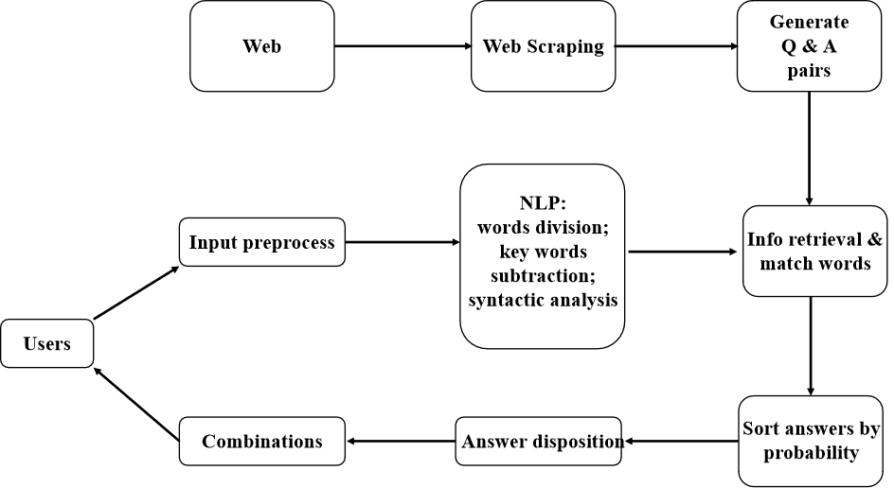
Structure of the chatbot
Financial Chatbot Based on LSTM -- Doraemon Group
3

Slide 8
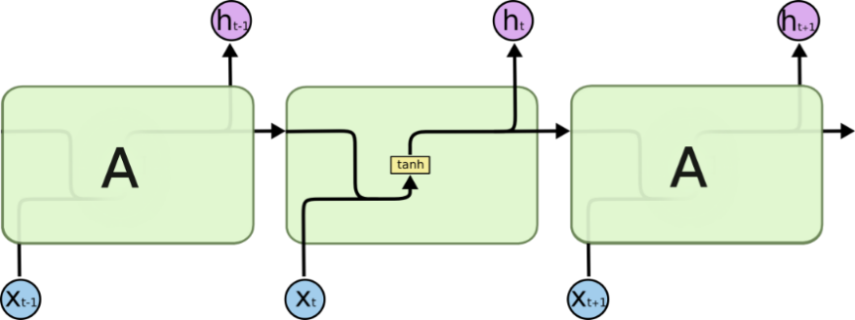

About LSTM
The repeating module in a standard RNN contains a single layer.
The repeating module in an LSTM contains four interacting layers.
Financial Chatbot Based on LSTM -- Doraemon Group
4

Slide 9
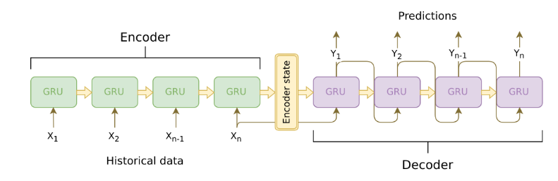
About Seq2Seq
Financial Chatbot Based on LSTM -- Doraemon Group
5

Slide 10
03
Conversational
Bot & crawler

Slide 11
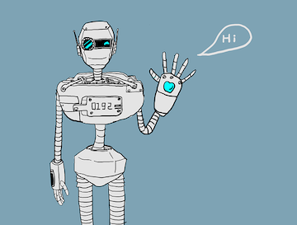
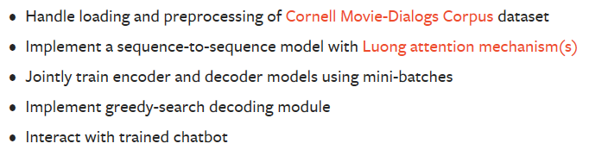
Neural Conversational Chatbot
Project Procedures
Financial Chatbot Based on LSTM -- Doraemon Group
6

Slide 12
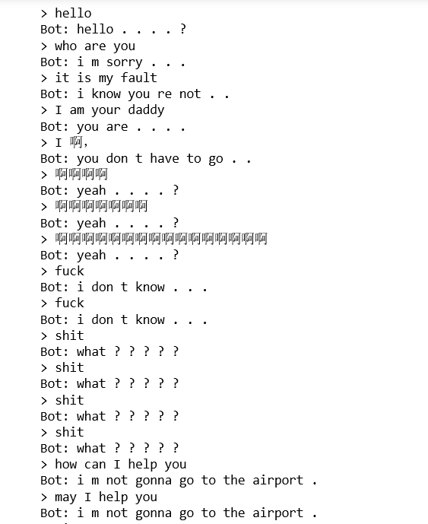
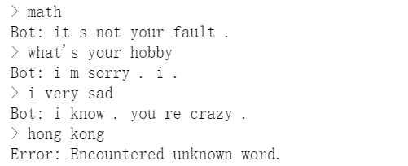
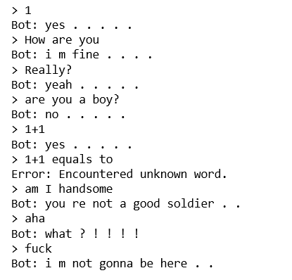
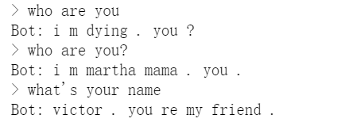
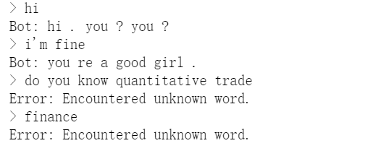
Q & A of Test
It seems not that good!
Financial Chatbot Based on LSTM -- Doraemon Group
7

Slide 13
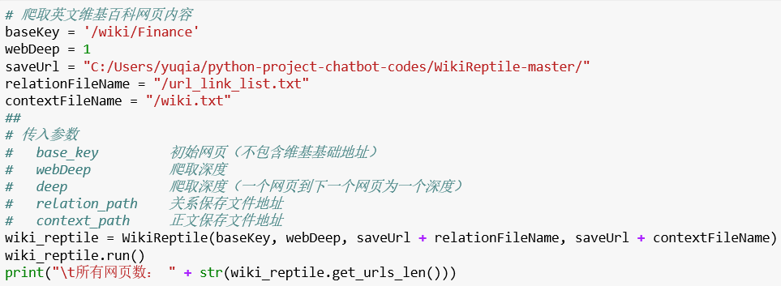
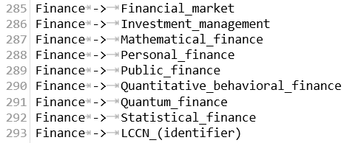
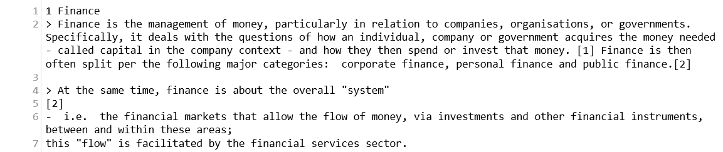
About Web Crawler
Financial Chatbot Based on LSTM -- Doraemon Group
8

Slide 14
04
Model
Procedures

Slide 15
Model Procedures
Step 1
Step 2
Step 3
Step 4
Data Cleaning
SGD Compilation and Model Fitting
Corpus Creation
Using LSTM for Encoder and Decoder
Query Processing and Prediction
Parameters Adjustment
Model Comparison
Graphical User Interface
Step 8
Step 7
Step 6
Step 5
Financial Chatbot Based on LSTM -- Doraemon Group
9

Slide 16
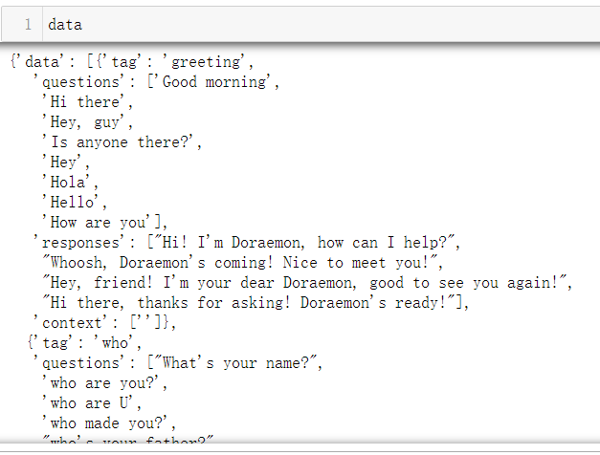
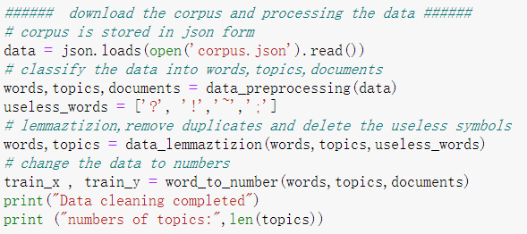
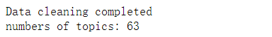
Step 1 & 2
1. Corpus Creation
2. Data Cleaning
Financial Chatbot Based on LSTM -- Doraemon Group
10

Slide 17
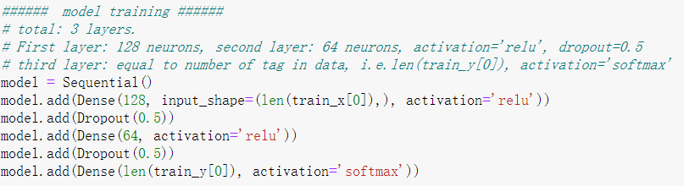
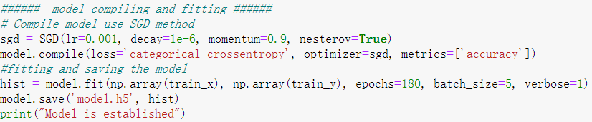
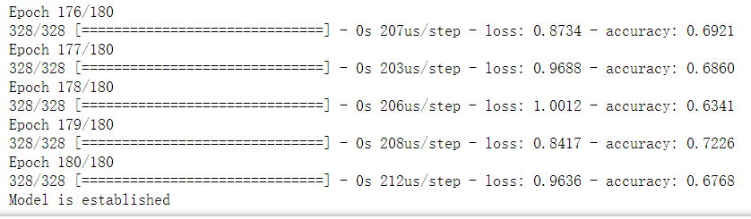
Step 3 & 4
3. Using LSTM for Encoder and Decoder
4. SGD Compilation and Model Fitting
Financial Chatbot Based on LSTM -- Doraemon Group
11

Slide 18
05
Model Results
& Summary

Slide 19
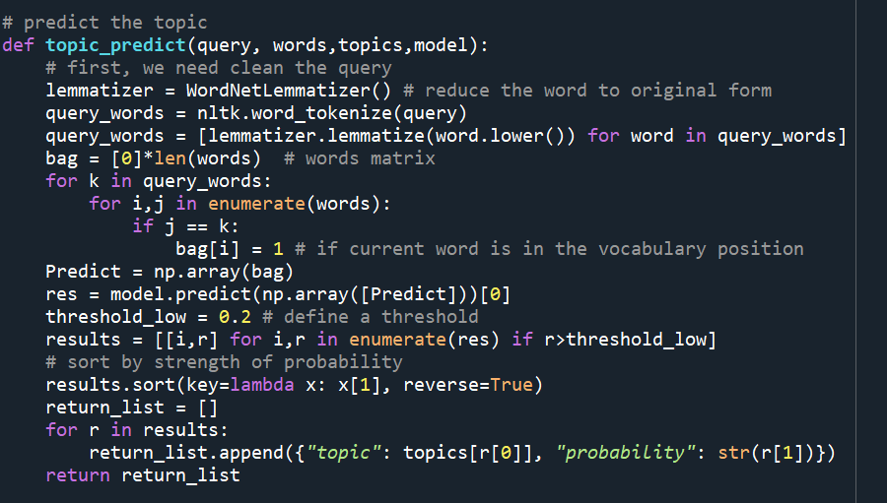
Model Results
5. Query Processing and Prediction
preprocess query: cut words and tokenize them
predict the topic
return an answer from the topic randomly
Financial Chatbot Based on LSTM -- Doraemon Group
12

Slide 20
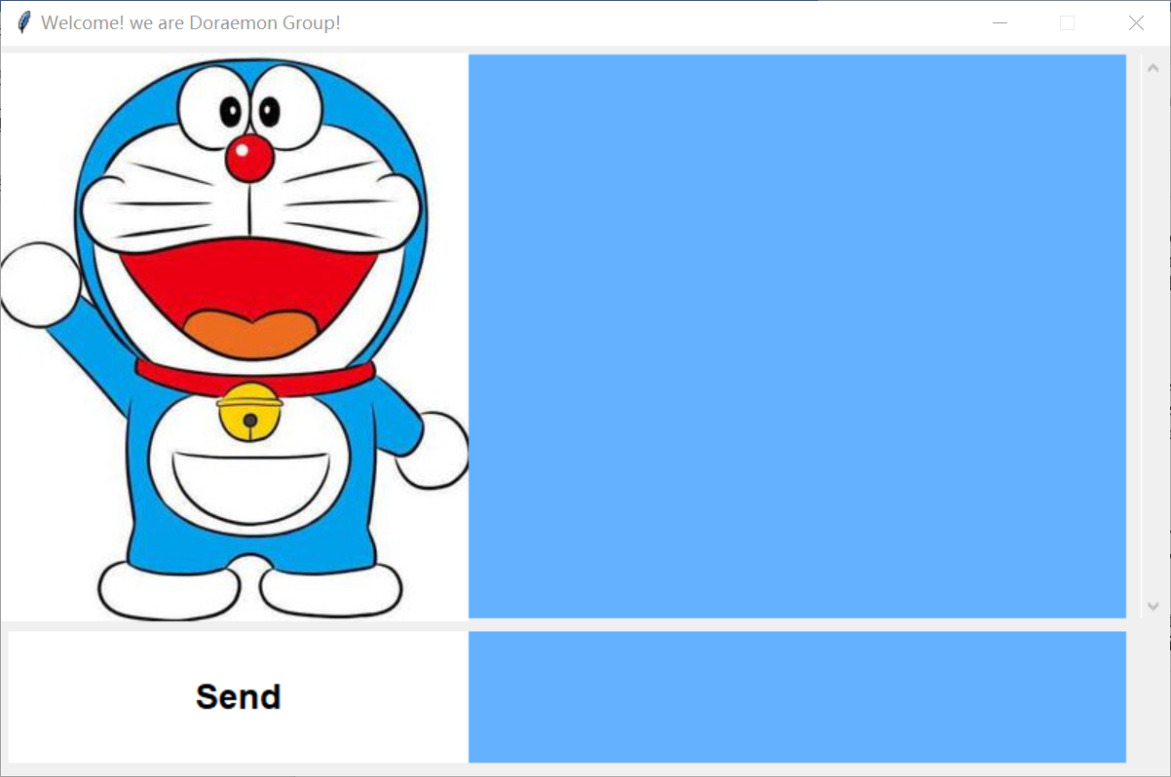
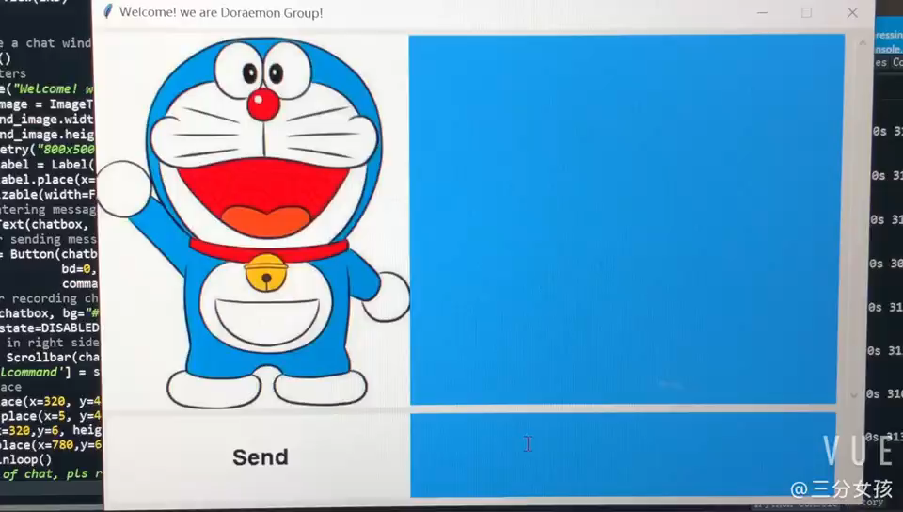
Model Results
6. Graphical User Interface (GUI): Tkinter library
Theme color
Welcome title
A dialog window: display and record queries and answers
Receive queries and process
Queries input by users
Financial Chatbot Based on LSTM -- Doraemon Group
13

Slide 21
Summary
Innovations:
Grab Wikipedia pages to bulid a financial corpus
Create a financial chatbot -unique & useful
Chat interface - pleasant and vivid
Further study:
Automatic learning topics
Financial Chatbot Based on LSTM -- Doraemon Group
14

Slide 22


Thanks for listening!
Group Doraemon
Liangde LI, 20653566
Qi Liu, 20659974
Linfeng Zhu, 20652201
Yuqiao Xie, 20655851
Yaxin Zhang, 20661795

